Slide 1
Project
ANALYSIS OF GERMAN CREDIT DATA
By Project Group 14
Rohith Kanakagiri
Sai Vinay Teja Jakku
Anurag Palanki
IE 6600 Computation & Visualization DAE Fall 2021

Slide 2
Data set description
The dataset used for this project was obtained from the UCI ML repository (GCD dataset). This dataset was donated to the public by Professor Dr. Hans Hofmann from the Hamburg University in 1994.
The dataset contains 1000 observations with 21 variables 14 of which are categorical, 7 numerical and an additional column classifying the applicants as a good risk or a bad risk.

Slide 3
Categorical data
Checking account:
This gives the range of money in checking account
Credit history:
This refers to the history of credit taken at banks.
Purpose:
The mentioned reason for taking a credit.
Saving account:
This gives the range of money in savings account.
Present employment:
The employment status of applicants while they were applying for credit.
Personal status:
This tells whether the gender of applicant and if the applicant is Single, Widowed or Divorced.
Guarantors:
This shows whether the applicant has a Guarantor.

Slide 4
Categorical Data
Property:
This depicts the most asset of the applicant.
Other installment plans:
This shows whether the applicant has any other installment plans.
Job:
This refers to the nature of job.
Telephone:
This columns shows if the applicant has a phone.
Foreign worker:
This shows if the applicant can be categorized as a foreign worker.
Risk Rating:
This shows whether the credit rating of the applicant is good or bad.

Slide 5
numerical data
There are no missing values in the dataset as seen from the table below.
Duration:
This gives the duration of credit in months
Credit amount:
This refers to the requested credit amount
Installment rate:
Monthly installment based on his income
Residence since:
This shows the number of years the applicant has lived at his present address
Age:
This gives the age of applicant.
Existing credit:
This shows number of existing credits at bank
Dependent:
This depicts whether the applicant has any dependents

Slide 6
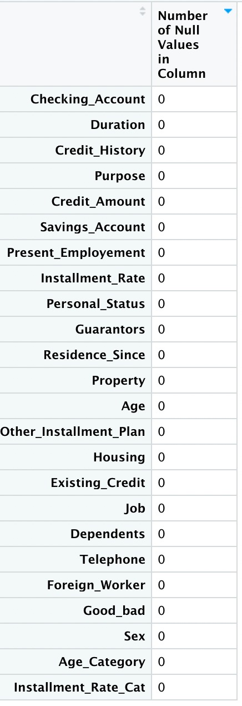
Data preprocessing
Age category
We have categorized the given data into Young, Middle age, Adult and Senior
Sex
We have used the personal status column to classify individuals as males and females

Slide 7
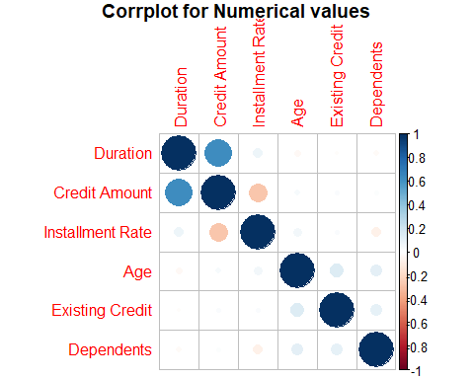
Corr plot to show correlation
Showing the correlation between various numerical values in the data frame

Slide 8
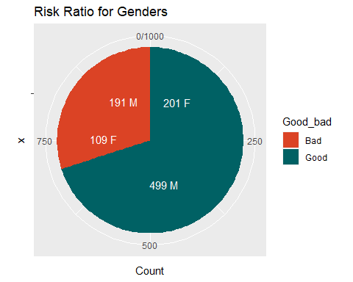
Pie chart depicting number of good bad male female
This pie chart shows that only 1/4 of male credit applicants are classified as bad ,whereas more than 1/3rd of the female applicants are classified as bad. We are trying to explore whether this is just a bias towards men or if the various attributes are diff in case of males and females

Slide 9
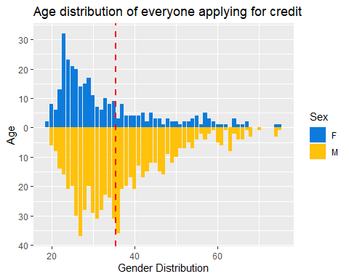
Pyramid plot
Pyramid plot of everyone's age showing almost equal number of young men and women applying for credit

Slide 10
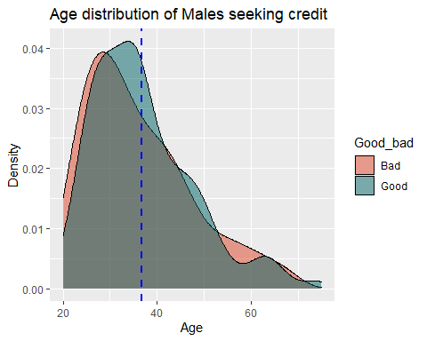
Density plot for men
Density plot of men applicants and age showing that the number of young men being classified as bad risk are slightly more than the number of young men being classified Good risk

Slide 11
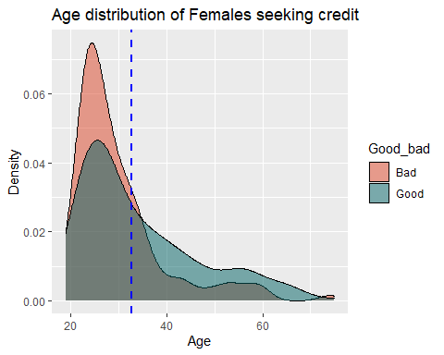
Density plot for women
Density plot of women applicants and age showing that the number of young females being classified as bad risk is drastically more than the number of young women being classified Good risk

Slide 12
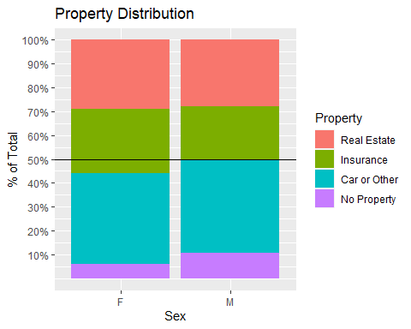
Stacked bar plot
Property vs gender shows us that the percentage of young women having property or building and society savings agreements/life insurances is more than that of men but in the end they are still rejected more

Slide 13
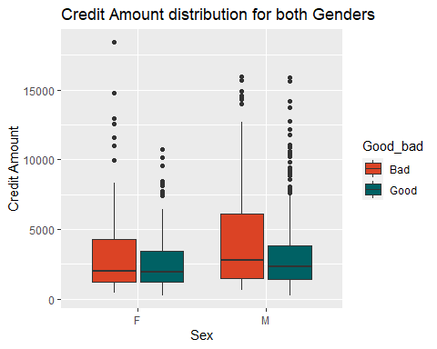
Boxplot for credit amount
This box plot shows higher credit amount is associated with higher rejections and lower credit amount has high approvals

Slide 14
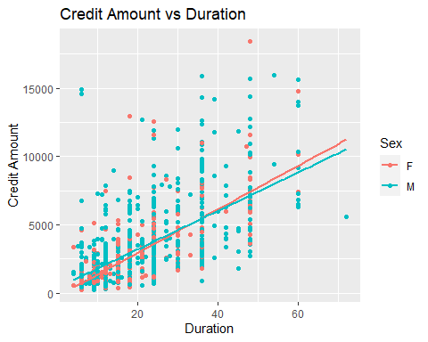
Scatter plot for credit amount and duration
Young women take up smaller amounts of loans than men for similar duration but contrary to the above plot the number of women getting rejected in this case are very high as compared to men

Slide 15
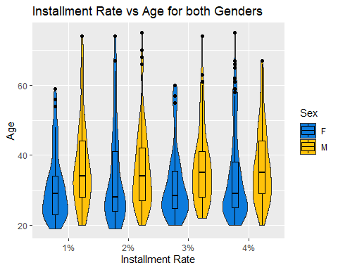
Violin box plot
Installment rate vs age for both genders

Slide 16
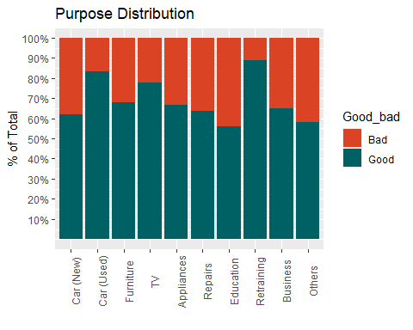
Stacked bar plot
This shows the distribution of purpose over the complete data classified as good or bad

Slide 17
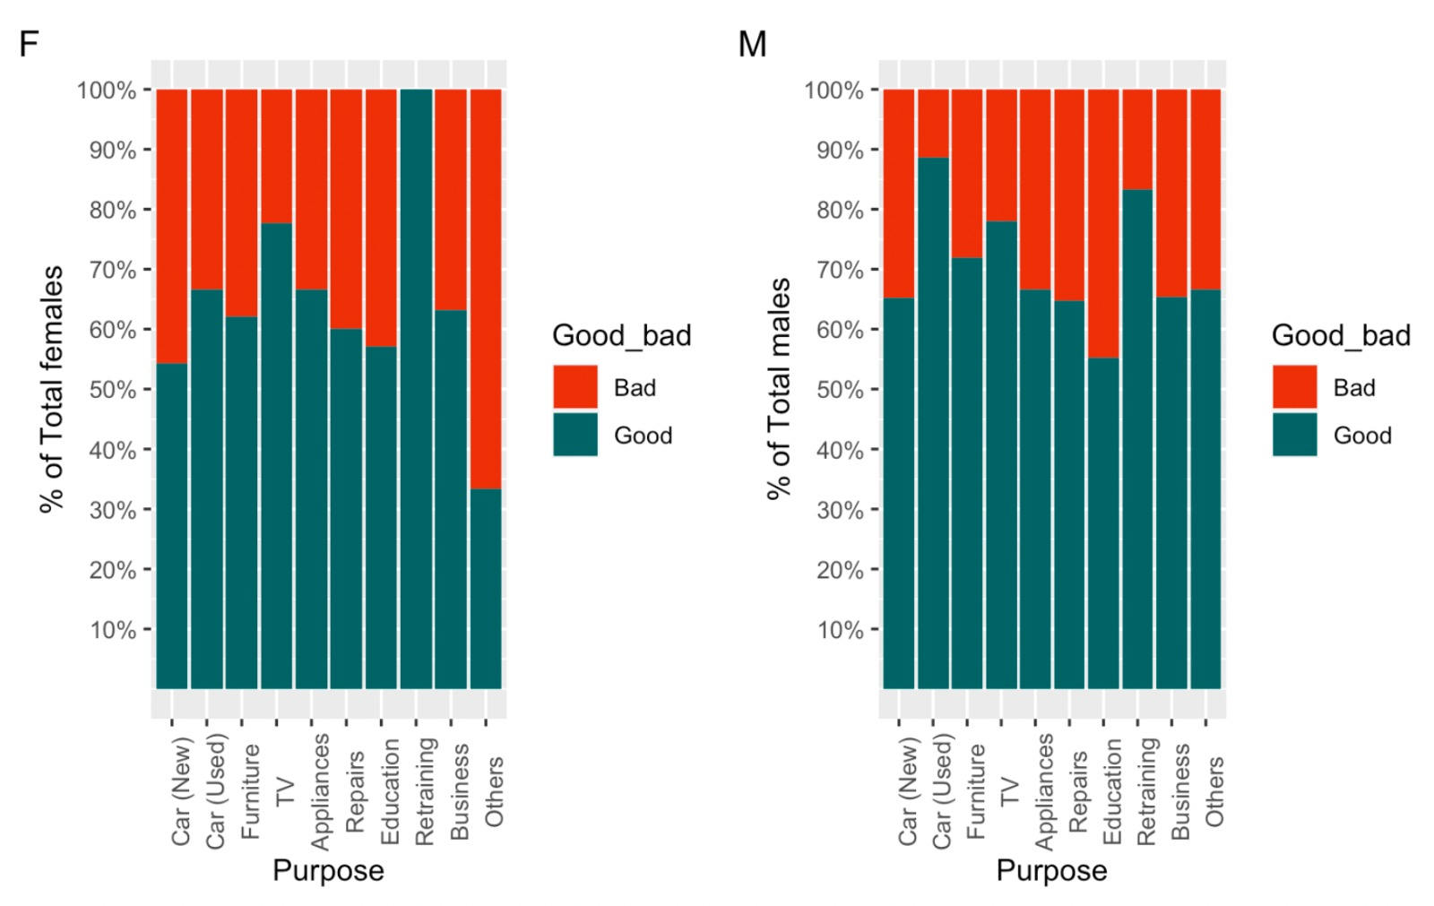
Stacked bar
Females are rejected more for similar purposes

Slide 18
conclusion
After going through all the variables that classify a customer as good or bad risk . we have chosen to depict the few features which show large discrepancies with males and females such as Credit amount, duration, age and Purpose
Among other socio-economic variables present, we covered gender variable in our analysis. As shown from the above charts, there is no discernible reason for the bad risk classification for females.
Hence we believe that there is a little bias towards female applicants asking for credit.

